Slide 1
A Primer on Functional Programming
Sarah Withee
@geekygirlsarah
Slides: geekygirlsarah.com/primer-fp

Slide 2
Who has heard of functional programming?

Slide 3
Who has done some form of functional programming?

Slide 4
Who IS a functional programmer?

Slide 5
Who has wanted to learn but never had time or good resources?

Slide 6
Intro
Functional Programming Concepts
Why Use Functional Programming?
Thinking Functionally
Brief Glance at Functional Programming Languages

Slide 7
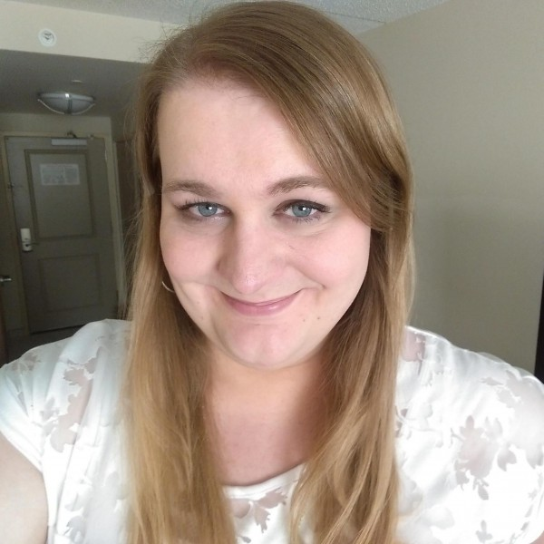
Hello!
I am Sarah Withee
I’m a software engineer at Arcadia.io
I’m on all the social media as @geekygirlsarah
(Yes, you can tweet all the things!)

Slide 8
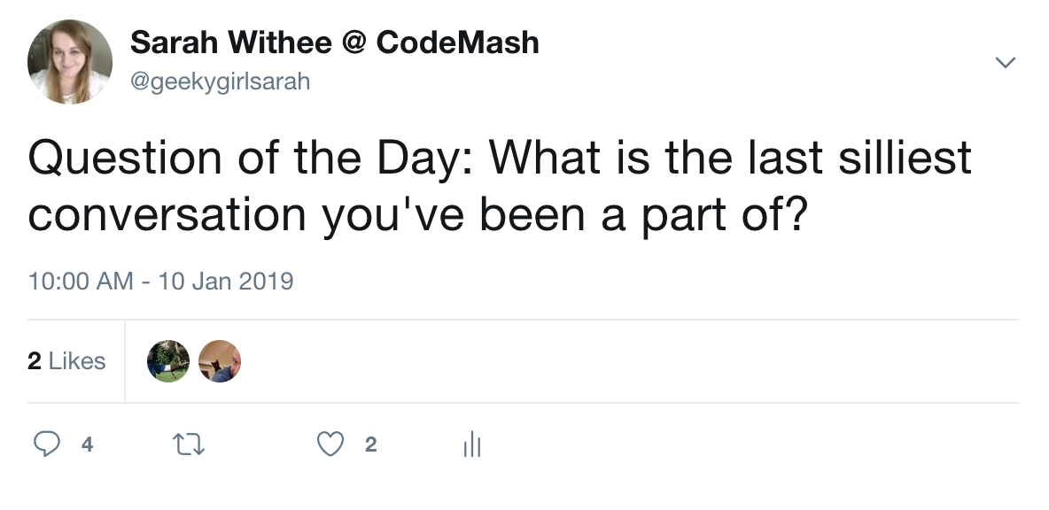

Slide 9
1. Functional Programming Concepts

Slide 10
Background
It’s not new!
(Languages and ideas have been around since 1950s)

Slide 11
Background
Built on ideas of lambda calculus developed in the 1930s
(I promise, we’re not discussing this today)

Slide 12
The Key Takeaway….

Slide 13
Pure Functions:
Function that, given a certain input, always produces the same output.

Slide 14
Functional Programming Concepts
Pure functions don’t have side effects

Slide 15
Functional Programming Concepts
Side effects include:
Time
File access
Database access
Network access
Previous function calls

Slide 16
Functional Programming Concepts
User input is never pure because users are unpredictable
(Duh.)

Slide 17
Functional Programming Concepts
Call by reference is never pure

Slide 18
Functional Programming Concepts
So…
It’s basically impossible to write software using 100% pure functions

Slide 19
FP Concepts > Examples
sin(x)
abs(x)
sqrt(x)
Always returns same values for x
Notes:
All math functions do this

Slide 20
FP Concepts > Examples
str.length()
str.isEmpty()
str.concat(str2)
Always returns same values for the string str (and str2)
Notes:
Generally functions based on simple data types will be like this

Slide 21
FP Concepts > Examples
getAccountNumberFromDb(acctOwner)
Kidding… definitely not pure.
Notes:
Why?
What if someone changes their name?
What if they close an account?
What if the number changes (like debit card stolen)?
What if database goes down?

Slide 22
FP Concepts > Review
Pure functions, given certain input, always produce same output
No side effects
User input is never pure
Call by reference is never pure
Impossible to write software in 100% pure functions

Slide 23
Referential Transparency
Any expression that can replace a function with its return value with no behavior changes

Slide 24
Functional Programming Concepts
Mathematical example:
If x = 3…
x + 5 = 8
3 + 5 = 8

Slide 25
Functional Programming Concepts
x = 144
y = sqrt(144) + 6 # y = 18
y = 12 + 6 # same

Slide 26
Functional Programming Concepts
Pure functions always have referential transparency

Slide 27
Functional Programming Concepts
In mathematics, all functions are transparent
In programming, this is NOT true

Slide 28
Functional Programming Concepts
Assignments are NOT transparent (“referentially opaque”)
x = x + 1

Slide 29
Functional Programming Concepts
def addOne(int num): return num + 1;
If x and y are the same, then
addOne(x) and addOne(y)
give same result

Slide 30
Functional Programming Concepts
More languages are starting to have immutable variables by default

Slide 31
Functional Programming Concepts
Lambda function (or anonymous function):
A function without a name

Slide 32
Functional Programming Concepts
Why lambdas?
For higher level functions or to pass arguments to a function
Usually used once to few times

Slide 33
Functional Programming Concepts
Lambdas can’t be recursive*
* otherwise they need a name or some way of maintaining state**
** which is possible but outside of this scope
Notes:
https://stackoverflow.com/questions/2067988/recursive-lambda-functions-in-c11
C++11: std::function<int(int,int)> sum;
sum = [term,next,&sum](int a, int b)->int {
if(a>b)
return 0;
else
return term(a) + sum(next(a),b);
};
C++14:
void f() {
static int (*self)(int) = [](int i)->int { return i>0 ? self(i-1)*i : 1; };
std::cout<<self(10);
}

Slide 34
Functional Programming Concepts
f = lambda x: x*x
print f(5)
lambda argument
variable
Function definition
x

Slide 35
Functional Programming Concepts
Functions ARE values
Can be passed as values into other functions
Notes:
A lot of the core of functional programming
Because of referential transparency and pure functions, this can be like passing in a regular value

Slide 36
def divide(x, y): return x/y
def divisor(d): return lambda r: divide (r, d)
half = divisor(2)
print(half(32))
lambda r: divide(r, 2)
divide(32, 2)

Slide 37
Functional Programming Concepts
Who has heard of map/filter/reduce?

Slide 38
Functional Programming Concepts
Who has used map/filter/reduce?

Slide 39
Functional Programming Concepts
Map – apply a function to all terms in a list
map(function, list)
Notes:
Depending on language, the order of arguments may swap

Slide 40
items = [1, 2, 3, 4, 5]
squared = map(lambda x: x**2, items)
# same as
squared = []
for i in items:
squared.append(i**2)

Slide 41
Functional Programming Concepts
Filter – creates a list for all items that match a filter (function returns true)
filter(function, list)

Slide 42
items = [1, 2, 3, 4, 5, 6, 7, 8]
under_5 = filter(lambda x: x<5, items)
# same as
under_5 = []
for i in items:
if (i < 5):
under_5.append(i)

Slide 43
Functional Programming Concepts
Reduce – returns result of some computation on a list
reduce(function, list)

Slide 44
items = [1, 2, 3, 4, 5, 6, 7, 8]
product = reduce(lambda x, y: x * y, items)
# same as
product = 1
for i in items:
product = product * num

Slide 45
Functional Programming Concepts
Note: Reduce works differently in different languages
reduce_left()
reduce_right()

Slide 46
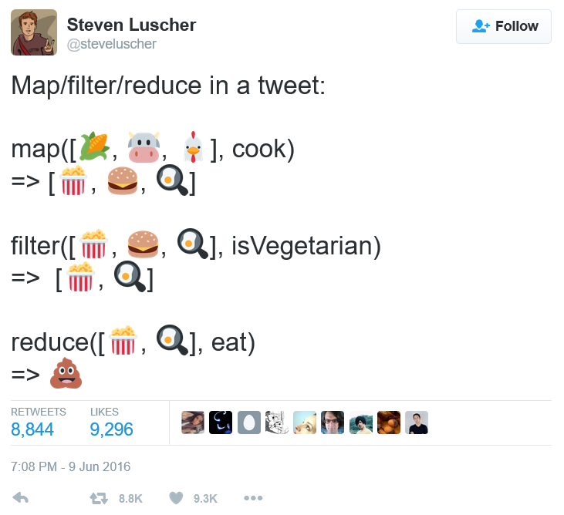
https://twitter.com/steveluscher/status/741089564329054208

Slide 47
2. Why Use Functional Programming?
Notes:
A lot of things thrown at you
The beginning might seem promising
The later stuff might just be weird
So…why?

Slide 48
Why Use Functional Programming?
Pure functions are simpler and faster to write

Slide 49
Why Use Functional Programming?
Pure functions that work correctly will always work correctly

Slide 50
Why Use Functional Programming?
Stack traces are a pain in OOP
Stack traces in FP simplify things

Slide 51
Why Use Functional Programming?
Unit testing IS* functional programming. No side effects make unit tests pass reliably.
* Well, should be anyway
Notes:
Set up environment
Run unit test
Assert the result
Clear out what you set up
Should affect nothing else

Slide 52
Why Use Functional Programming?
Global state of program isn’t affected by pure functions

Slide 53
Why Use Functional Programming?
Concurrency is WAY easier

Slide 54
Why Use Functional Programming?
As code grows larger, it’s all more reliable
Better small modules
-> better large modules

Slide 55
Activity 1
In a moment, everyone will stand up.
The count starts at 0
Each person will take the previous number, add 1 to it
Say the number out loud
Sit down
Repeat 2-4 until everyone is sitting
Last person reports the total

Slide 56
Activity 2
In a moment, everyone will stand up.
Count yourself at first (1)
Find a neighbor
Total your two numbers together
One of you sits down
Repeat steps 2-4 for each person in the row
Someone will return the final result

Slide 57
Why Use Functional Programming?
Activity 1 was like a for/while loop
x = x + 1
Took a long time

Slide 58
Why Use Functional Programming?
Activity 2 was (hopefully) recursive and concurrent
Many were counting (no side effects)
“Reduce” all the totals together

Slide 59
3. Thinking Functionally

Slide 60
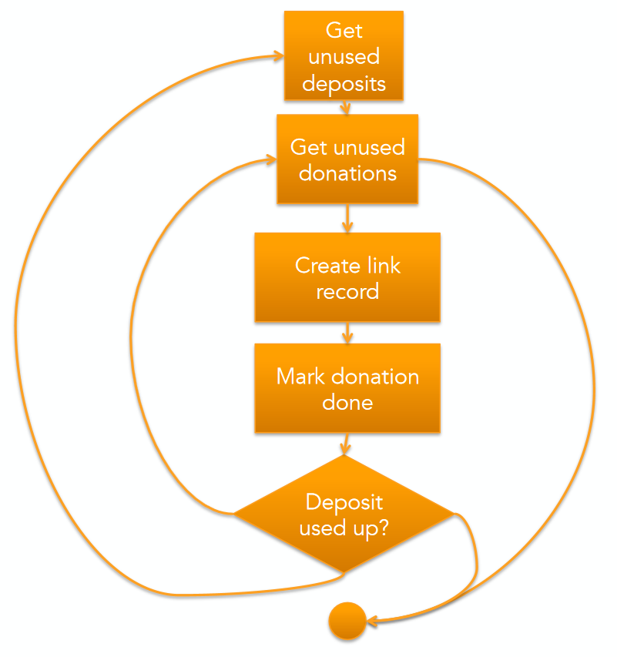
Curtesy of Jessica Kerr (@jessitron)
Notes:
A more imperitive/OOP way of doing non-profit donations

Slide 61
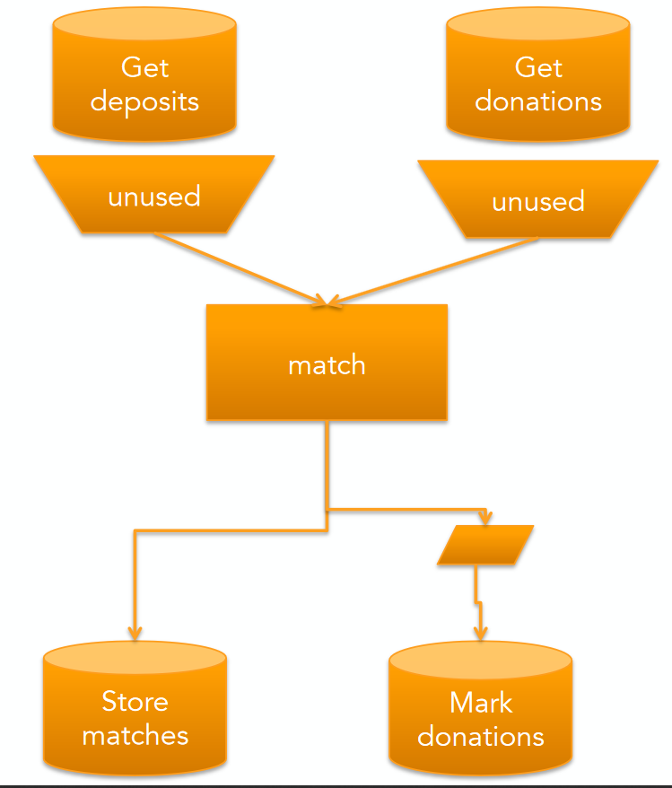
Curtesy of Jessica Kerr (@jessitron)
Notes:
A more imperitive/OOP way of doing non-profit donations

Slide 62
4. Brief Glance at Functional Programming Languages

Slide 63
Functional Languages (Pure)
Agda
Charity
Clean
Coq
Cuneiform
Curry
Disciple
Elm
Frege
Futhark
Haskell
Hope
Idris
Joy
KRC
Mars
Mercury
Miranda
Purescript
SAC
SASL
SequenceL
Notes:
22 languages (at least)
They don’t allow side effects and guarantee referential transparency
KRC = Kent Recursive Calculator
SAC = Single Assignment C
SASL = St. Andrews Static Language

Slide 64
Functional Languages (Impure)
ActionScript
Alice
APL
ATS
CAL
C++ (since C++11)
C#
Ceylon
Clojure
Common Lisp
Curl
D
Dart
Dylan
ECMAScript
Emacs Lisp
Erlang
Elixir
F#
Groovy
Hop
J
Java (since JDK8)
JavaScript
JMP Scripting Language (JSL)
JScript
Julia
Kotlin
LFE
Little b
Logo
Mathematica
Nemerle
Nim
OCaml
Opal
OPS5
PHP
Python
Q (both of them)
R
Red
Ruby
REFAL
Rust
Scala
Scheme/Racket
Spreadsheets
Standard ML (SML)
Tea
Wolfram Language
Notes:
50 languages (at least)
For the most part, they implement lambdas and passing functions around (map/filter/reduce)
Any surprises in here?

Slide 65
5. Conclusion

Slide 66
Conclusion
Functional programming is getting more popular, but been around for decades
Functional principles make your code simpler, smaller, more reliable
Functional concepts can work in nearly any language

Slide 67
Thanks!
Any questions?
You can find me at
@geekygirlsarah
hello@sarahwithee.com
Slides: geekygirlsarah.com/primer-fp

Slide 68
Credits
Special thanks to all the people who made and released these awesome resources for free:
Presentation template by SlidesCarnival
Example images by Jessica Kerr (@jessitron)

Slide 69
Presentation design
This presentation uses the following typographies and colors:
Titles: Montserrat bold
Body copy: Montserrat light
You can download the fonts on this page:
https://www.fontsquirrel.com/fonts/montserrat
Yellow #ffc800 · Orange #ffa400 · Raspberry #f64646 · Crimson #e8062f

